Slide 1
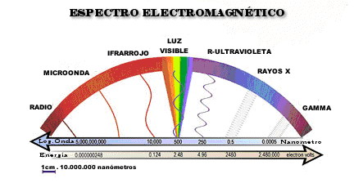
Listening to Hypercolors

Slide 2
Basic Ideas of Fourier Analysis

Slide 3
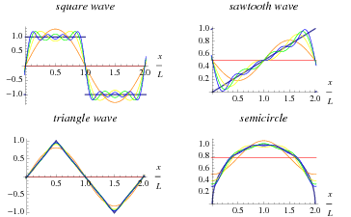
Fourier analysis is a very powerful mathematical tool, widely used in many branches of science and engineering.
A standard example is the analysis of a vibrating string into sinusoidal “normal modes”:

Slide 4
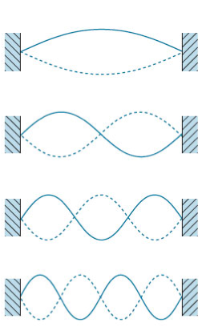
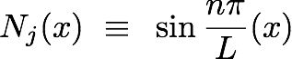
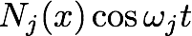
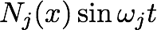
x=0
x=L
modes

Slide 5
Video Sonido
Youtube: What Does Sound Look Like SKUNK BEAR

Slide 6
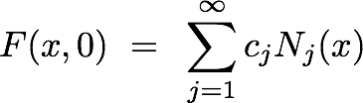
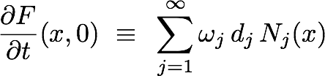
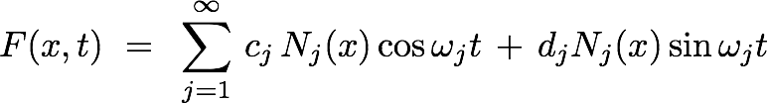
Fourier expansion
(There’s a nice formula for calculating the cj and dj .)
Dynamical solution

Slide 7
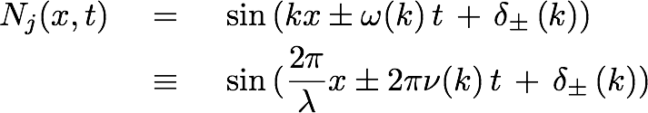
We have to adapt things a bit in order to address traveling waves in free space:
where often ω(k) = c k

Slide 8
… and there are many other extensions and variations, including:
modes of extended objects with arbitrary shapes
other equations (heat equation, Schrodinger equation)
(for electromagnetism): polarization
These matters take up a big part of “mathematical methods of physics”, and are treated in many textbooks.

Slide 9
Bottom line, for our purposes:
We can analyze any signal into a weighted sum of normal modes.
We can synthesize any signal using a weighted sum of normal modes.
In the case of visible light, normal modes are spectral colors.
In the case of audible sound, normal modes are pure tones.

Slide 10
More About Information Spaces and Dimension

Slide 11
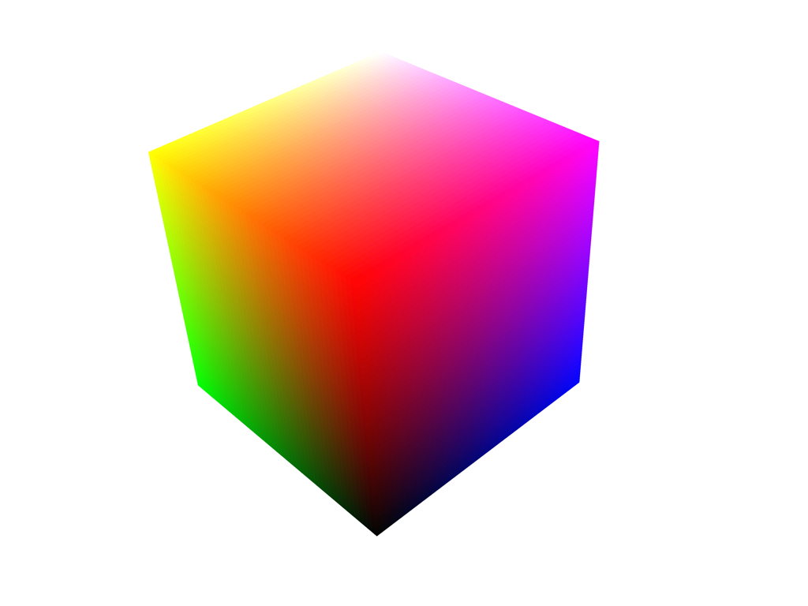
We can represent the possible outputs of three color generators (e.g. RGB) with variable intensity using a color cube:

Slide 12
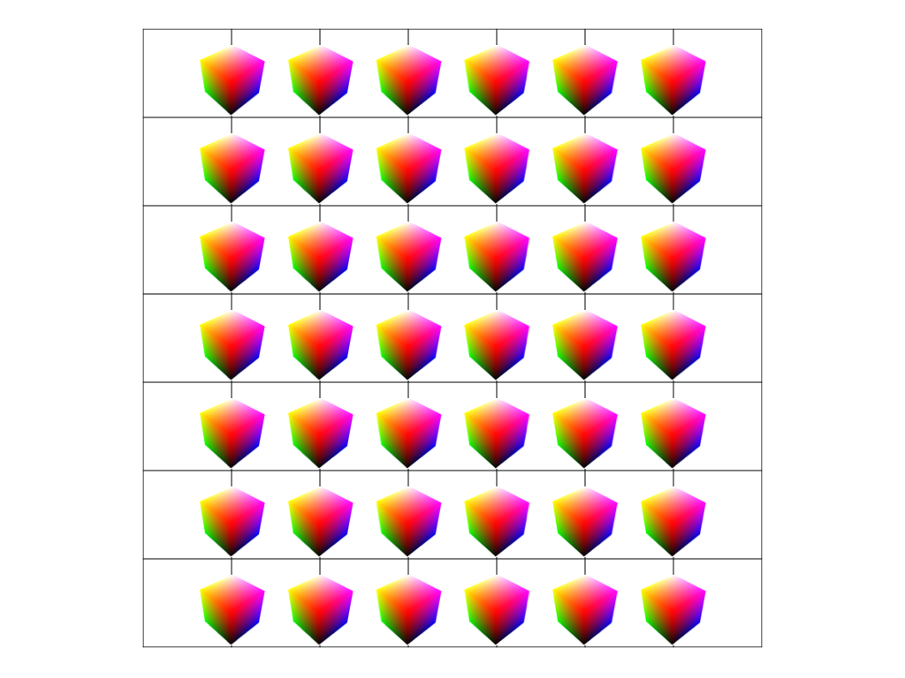
Using that concept, we realize that a computer display picks out points in a 5+1 dimensional space-time:
(t, x, y, r, g, b)

Slide 13
We can also define, in the same way, a “tone cube” for (say) C-E-G chords.
Humans can recognize that there are three tones, and judge their relative intensities. (How well? - an interesting question!)
We can, for example, map (R, G, B) -> (C, E, G) and “hear” colors and chords.

Slide 14
But we don’t have to stop there. We can have tone tessaracts, or hypercubes of arbitrary dimension.
In this way we can encode hyperspectral images, or other high-dimensional data (HDD) attached to positions.
Alternatively, we can quick-play through “scales”, mapping coordinates in HDD to the notes’ intensities.

Slide 15
Video Maths and Music Minuto 2 Youtube: The Science Behind the Arts The Maths Behind Music

Slide 16
What is Color Vision For?

Slide 17
Vision, in general, is a way of getting information from distant objects.
In this respect it differs from the chemical senses, smell and taste.
But since the frequency-dependent reflectance of a material depends on its chemistry, color vision is a way of getting chemical information at a distance.

Slide 18
For example, you can find good fruit in an arboreal environment. This may be why primates have especially good color vision (among mammals).

Slide 19
In the biological world, color is often used for signaling.
Plants signal “nectar here”, tree frogs signal “I am poisonous”, and so forth.
Clever animals often use color for signaling their reproductive fitness:

Slide 21
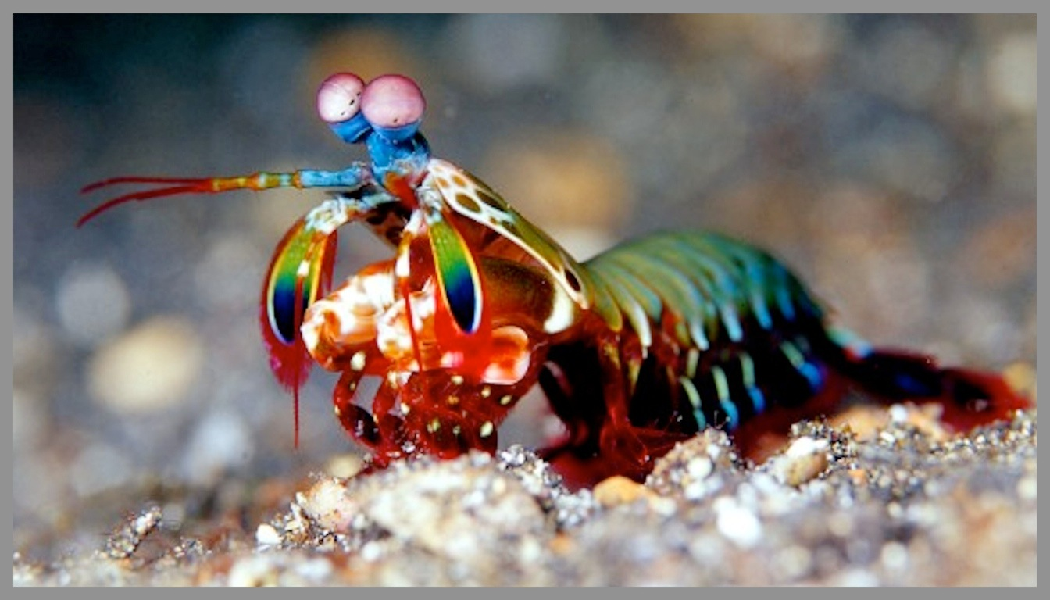

Slide 22
Synesthesia

